Slide 1
BOX-CITY
Urban Design / Community
Spring 2020
Hilliard Art Museum
Grades K-2

Slide 2
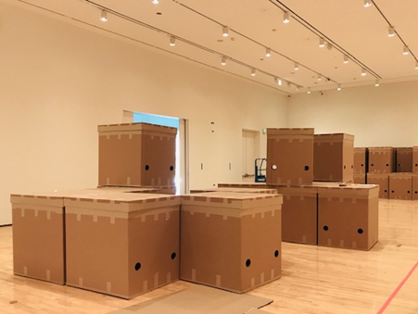
Robert C. Tannen | BOX-CITY is an interactive exhibition using cardboard boxes as to-scale models that allow museum visitors to explore designing their own city.

Slide 3
Robert C. Tannen is an artist and regional planner, who lives in New Orleans, LA. He designed BOX-CITY to encourage people to think about how we will live in the future.

Slide 4
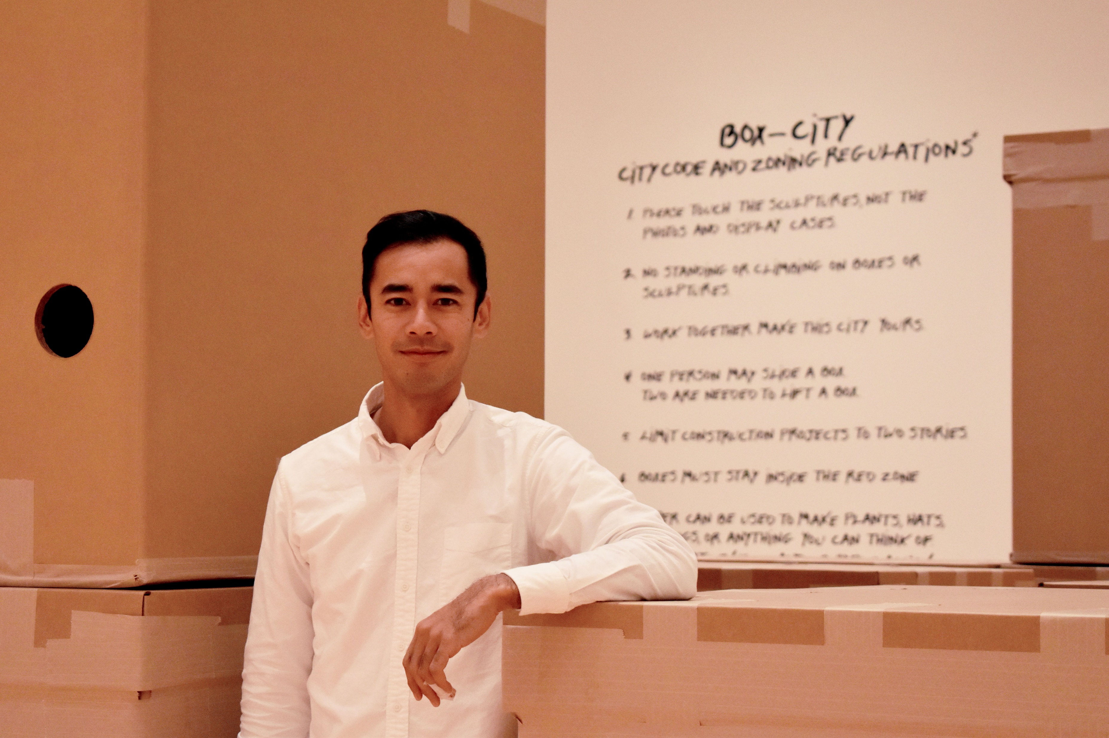
Phanat is an urban designer and community organizer. He lives and works in New Iberia, LA. He is the Hilliard Art Museum’s Teaching Artist in Residence for Spring 2020 and will be your guide at the museum.

Slide 5
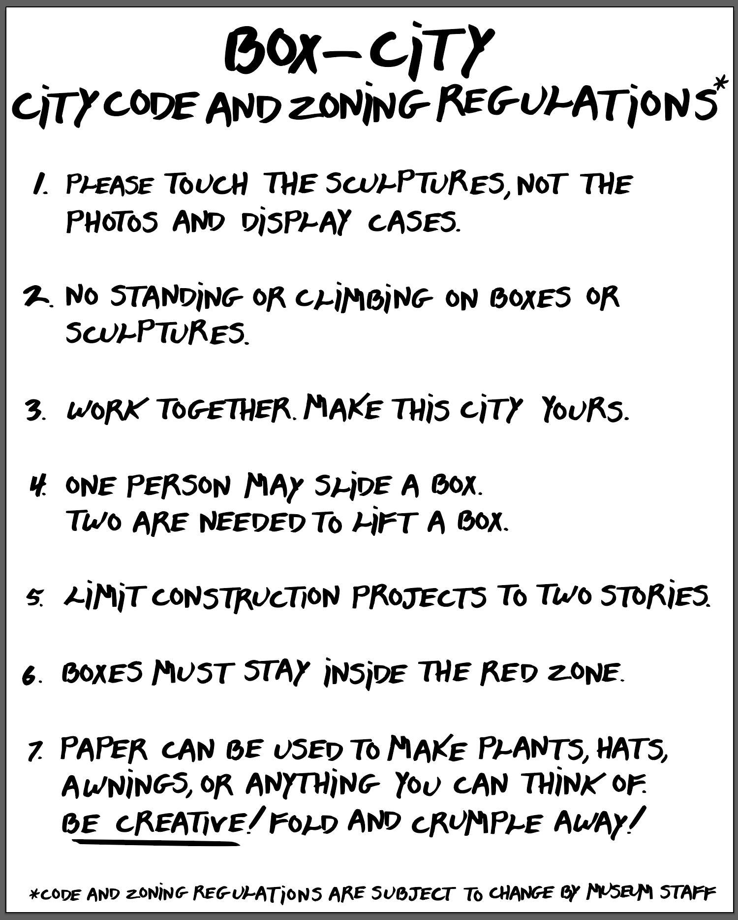
BOX-CITY
Building Code
Guidelines for Building

